Slide 1
Practical 3
The Web Browsers.

Slide 2
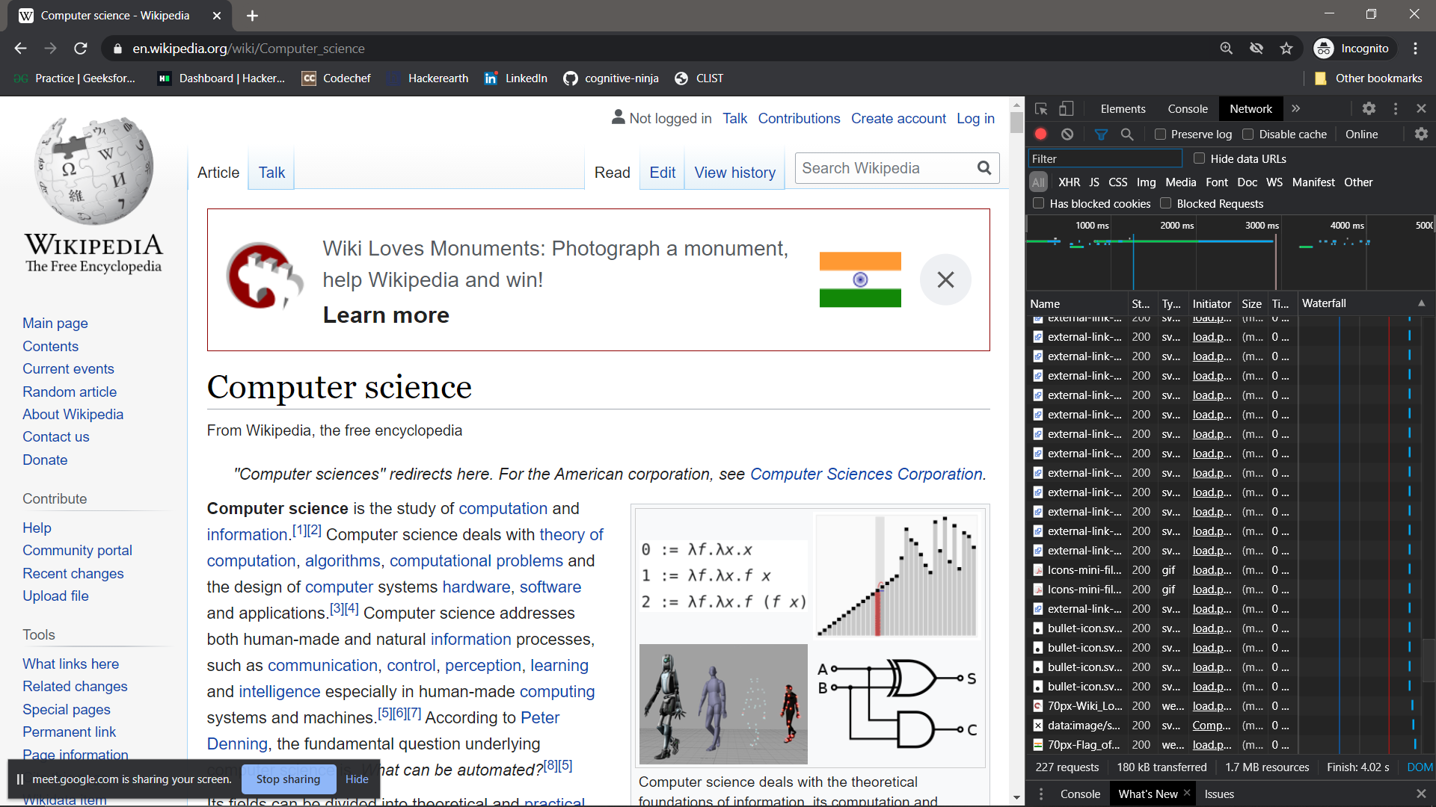
Chrome 1
Chrome

Slide 3
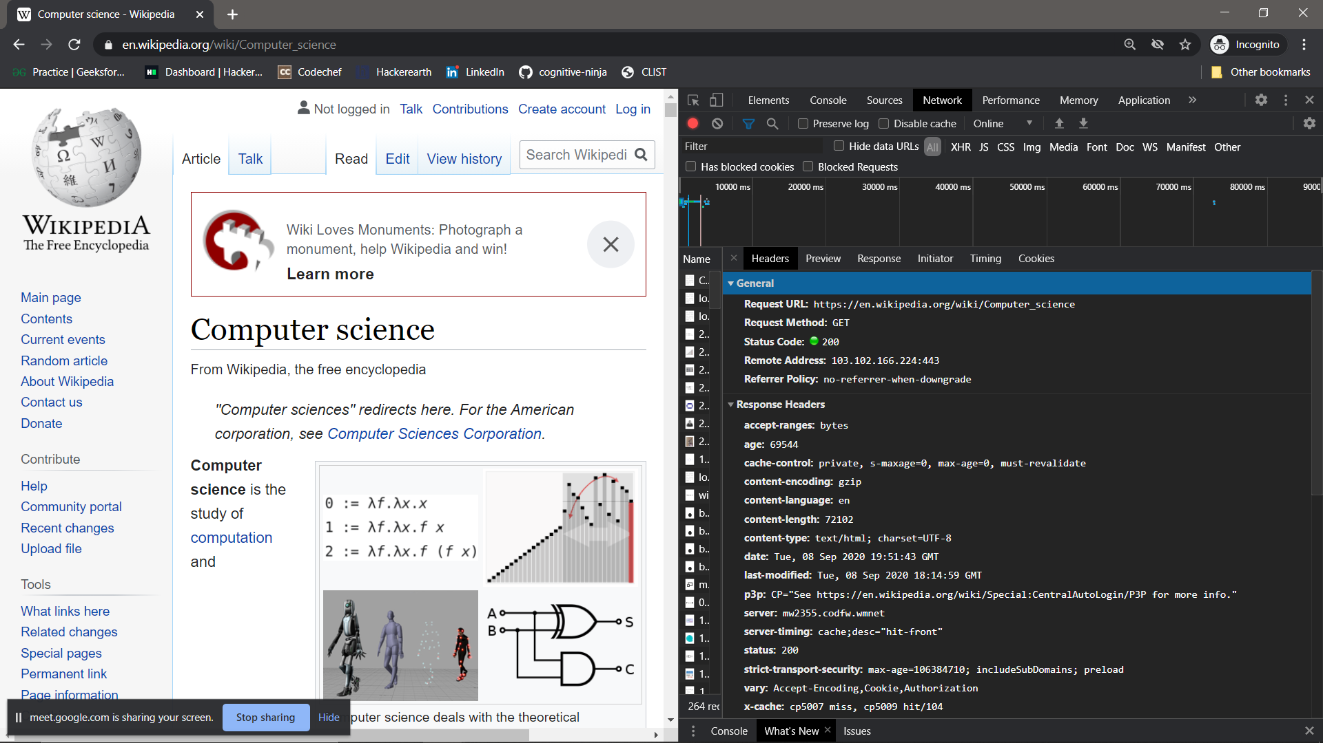
Chrome 2

Slide 4
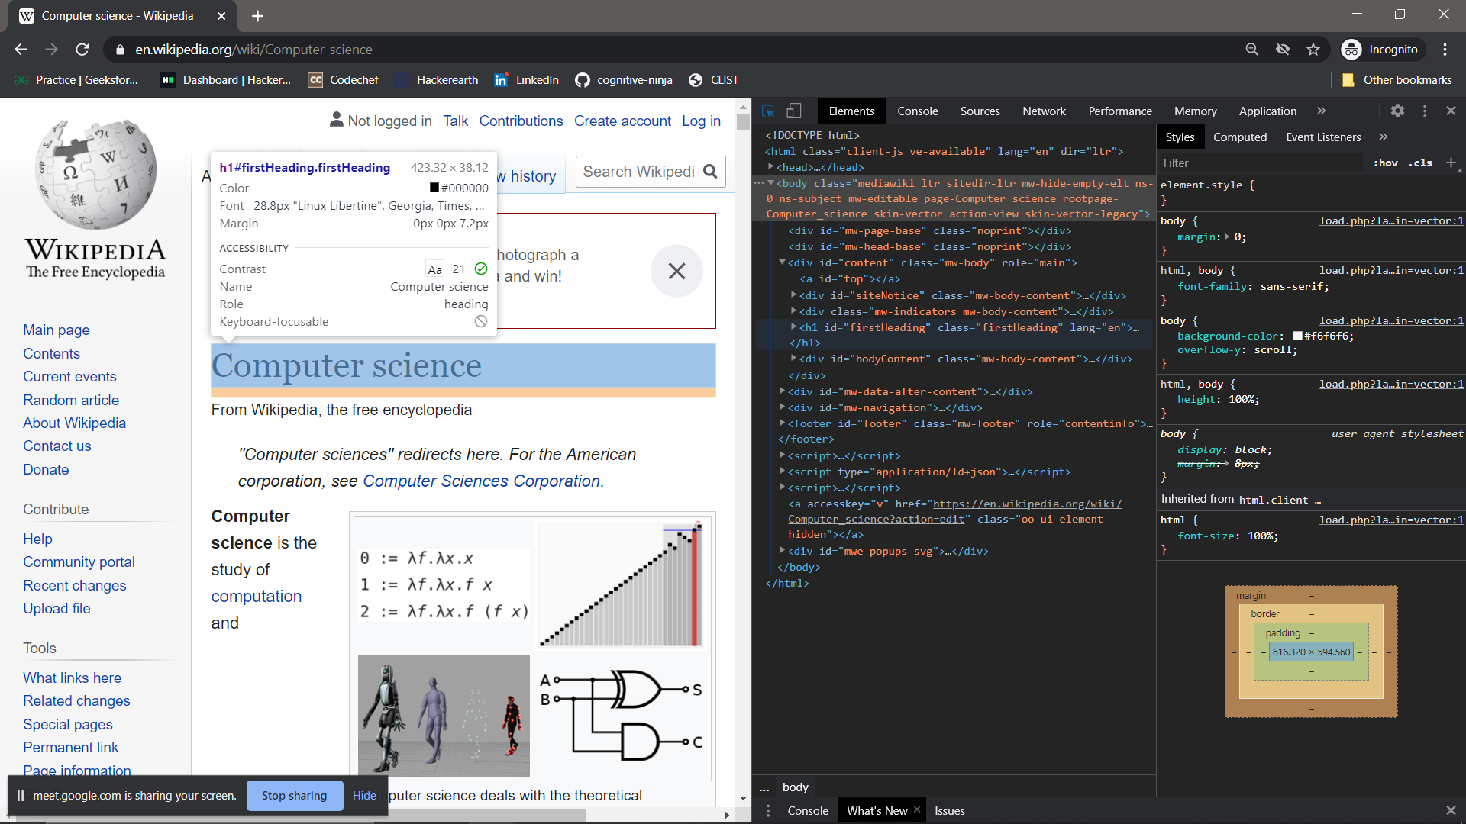
Chrome 3

Slide 5
Chrome 4
Blink
V8

Slide 6
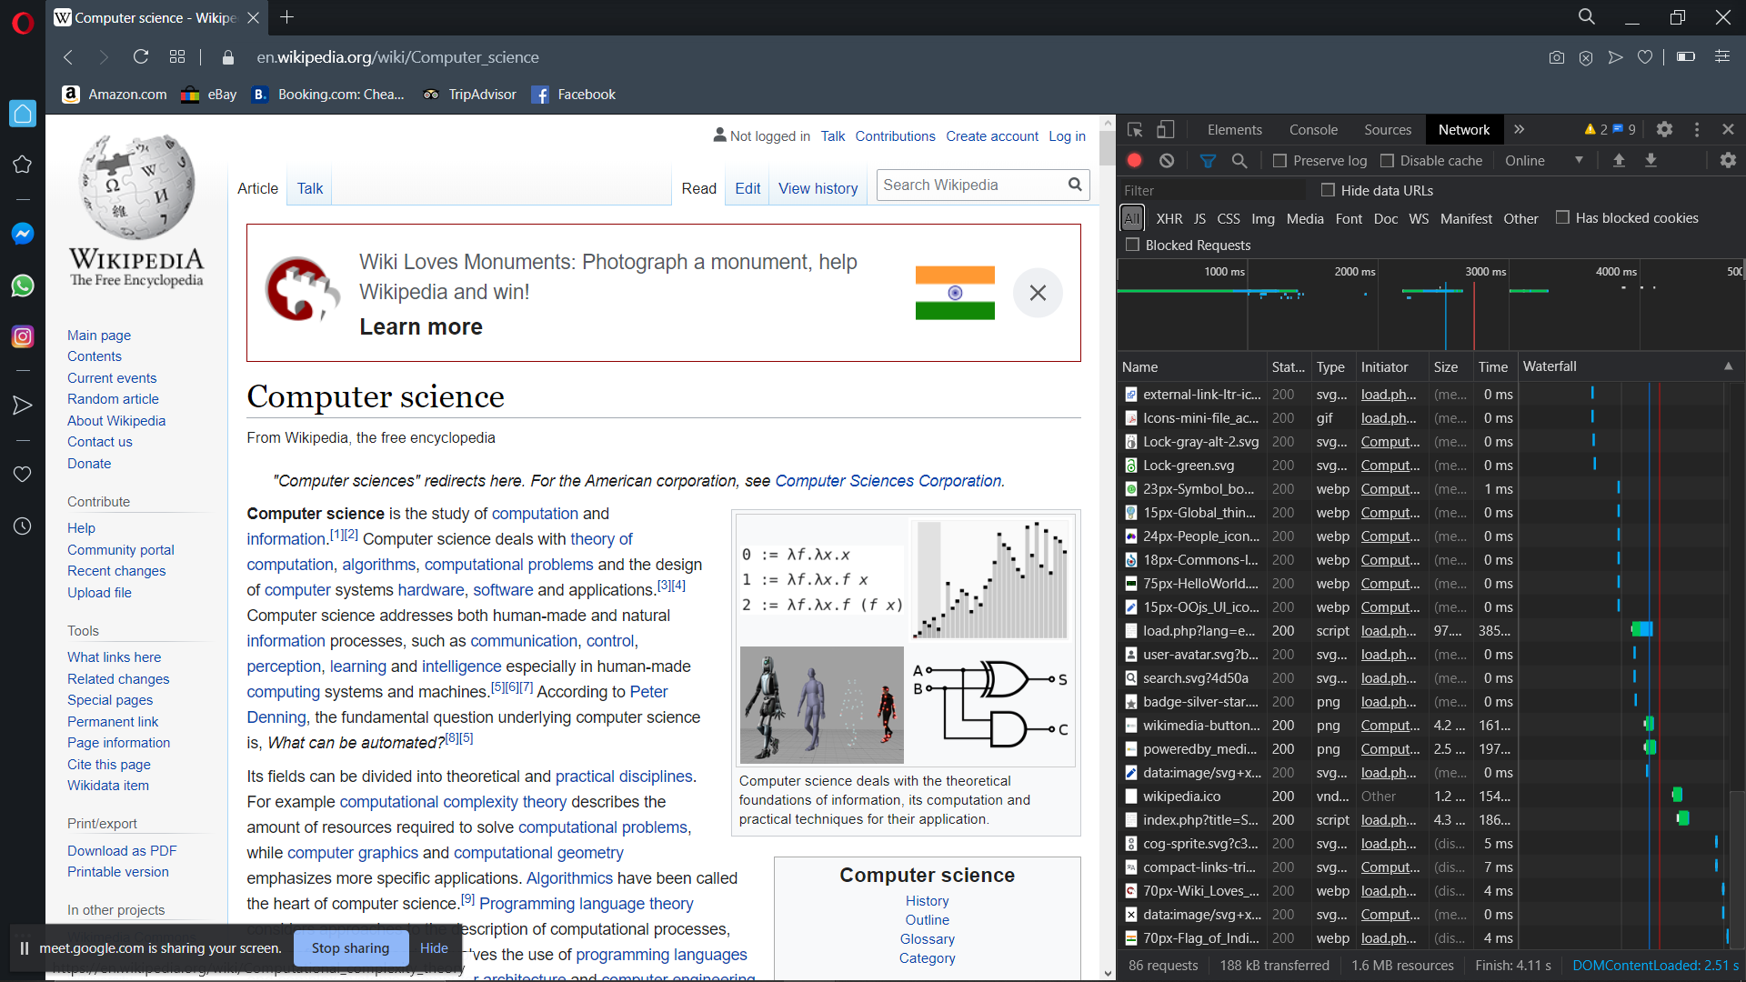
Opera 1

Slide 7
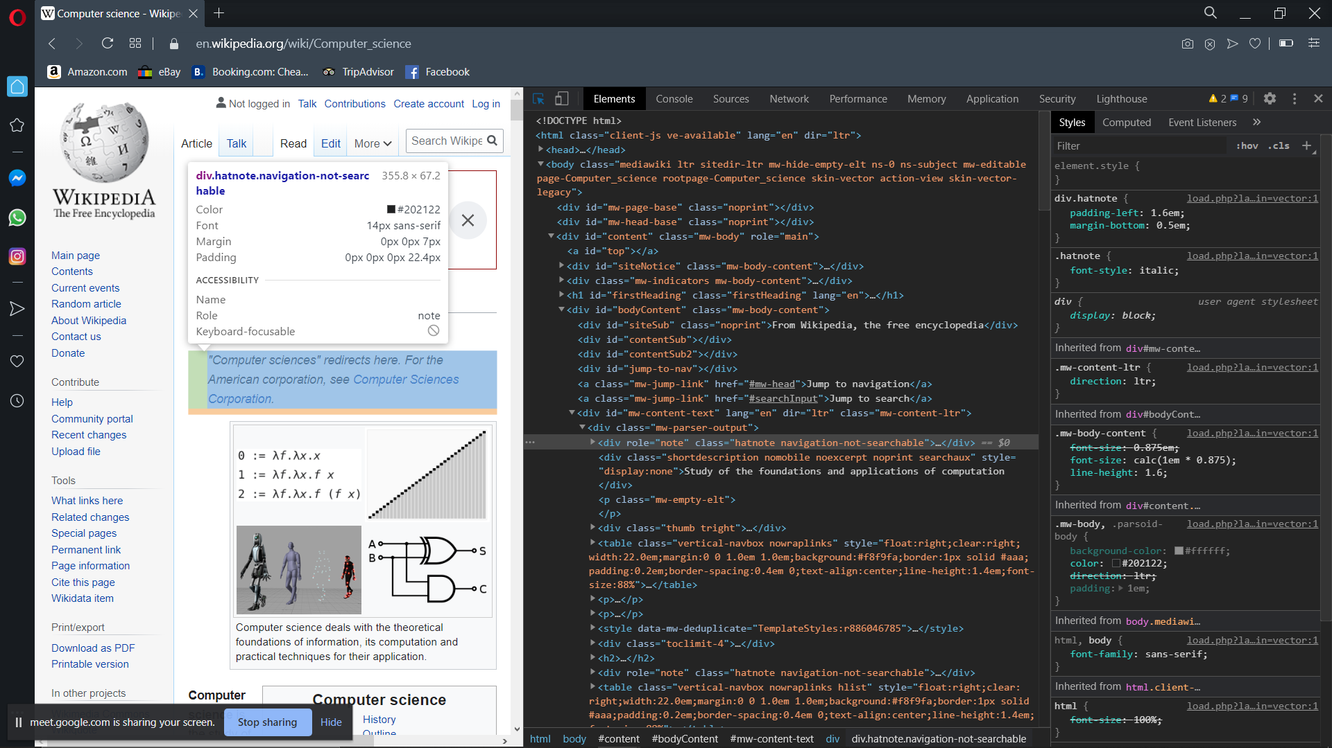
Opera 2

Slide 8
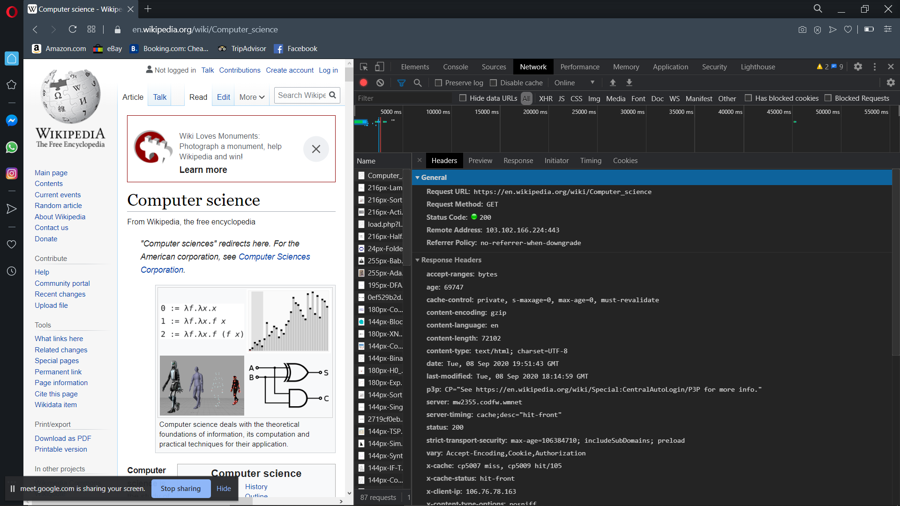
Opera 3

Slide 9
Opera 4
Blink
V8

Slide 10
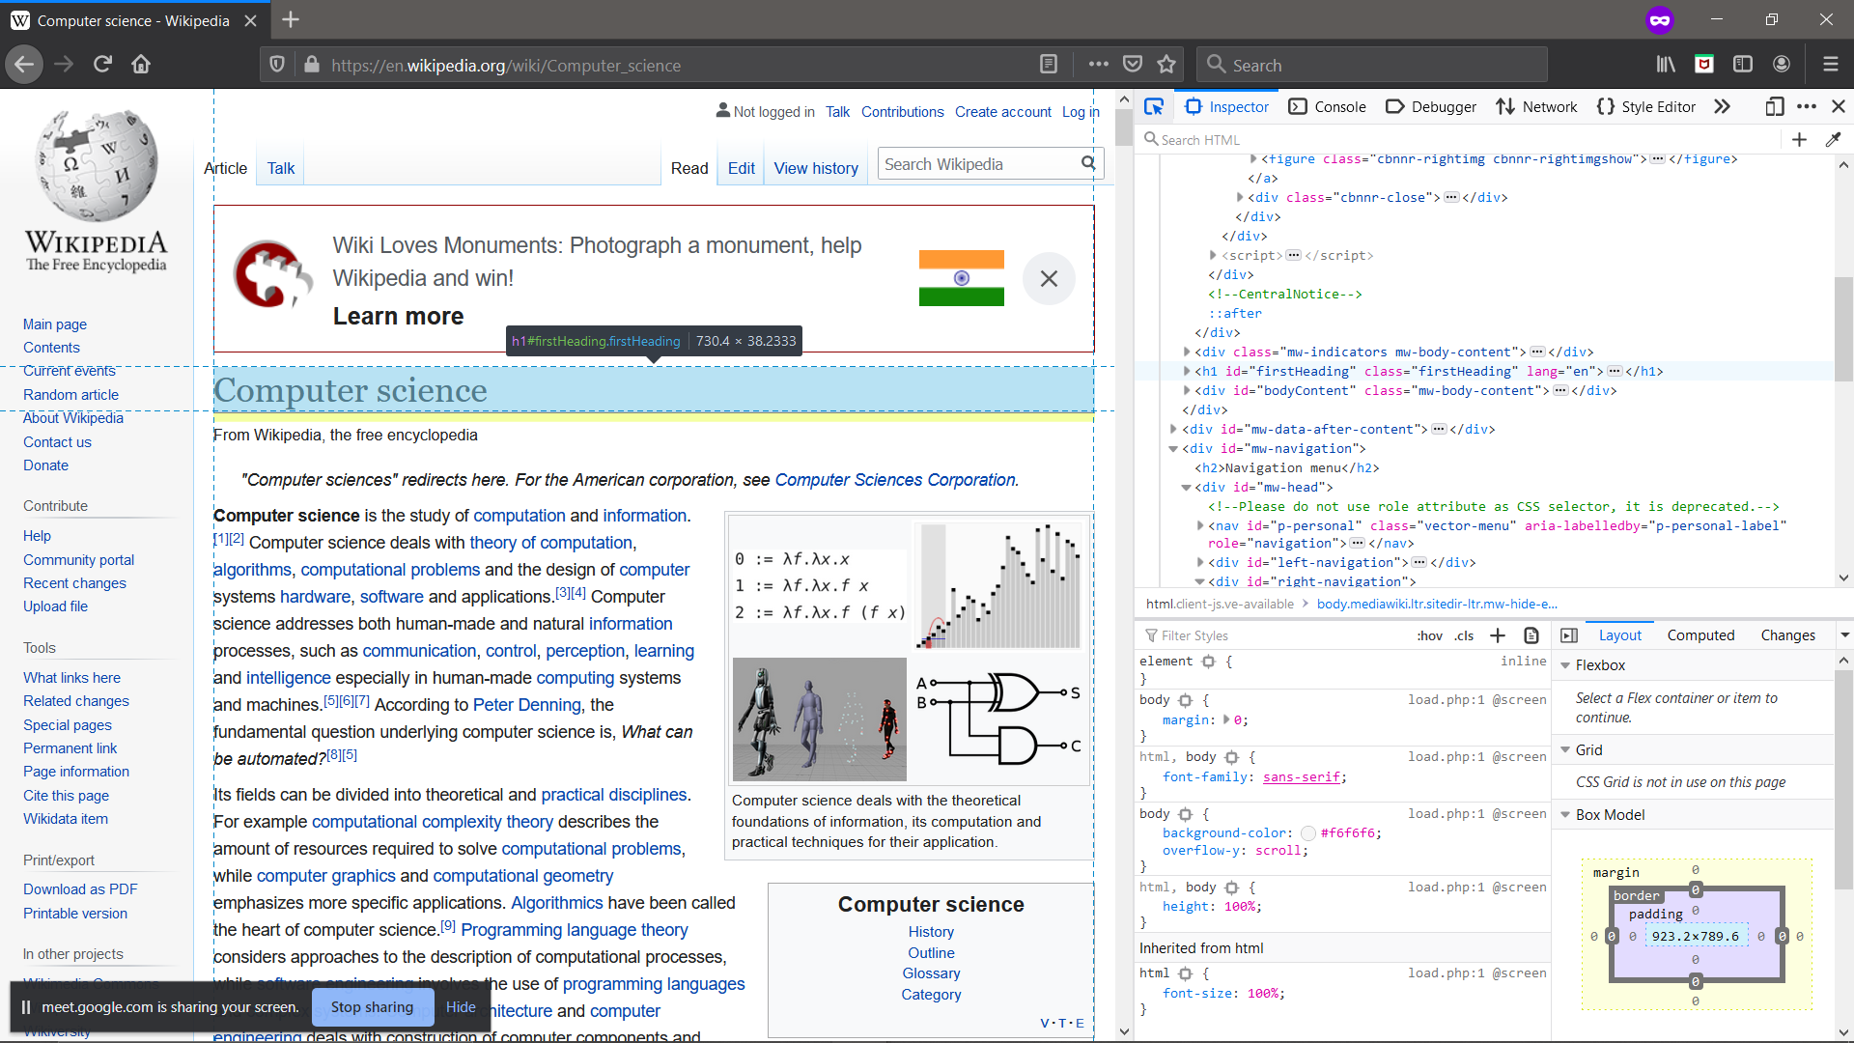
Mozilla Firefox 1
Notes:
- Free open-source
- Developed by the Mozilla Foundation and its subsidiary, the Mozilla Corporation.
- Uses the Gecko layout engine to render web pages, which implements current and anticipated web standards.

Slide 11
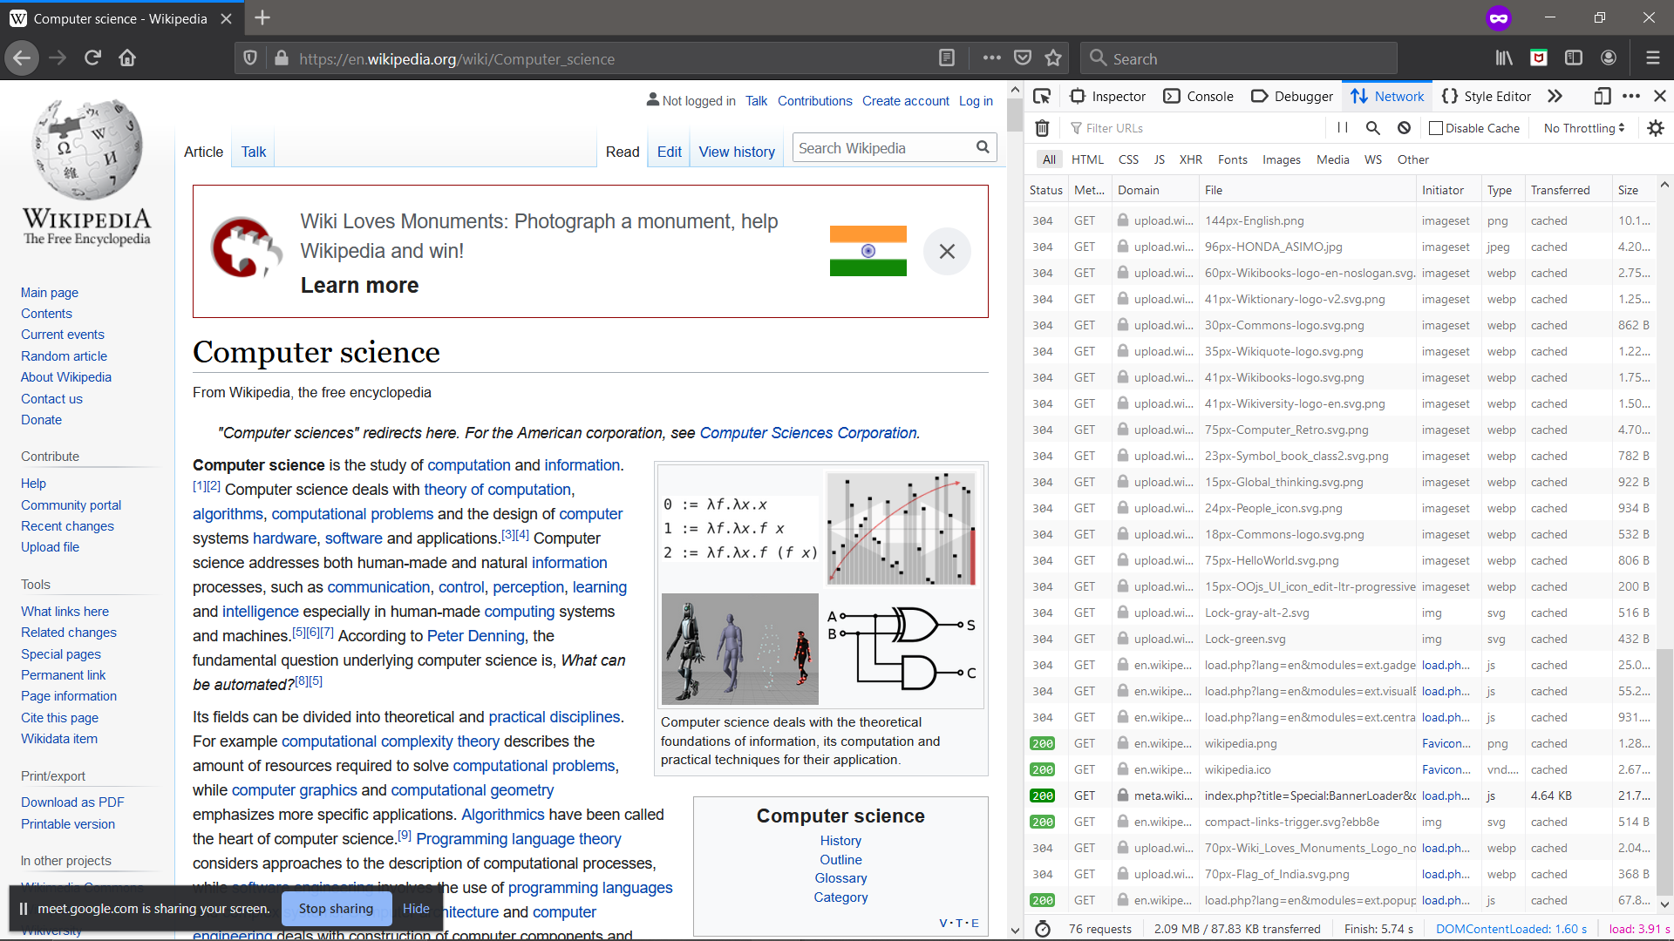
Mozilla Firefox 2

Slide 12
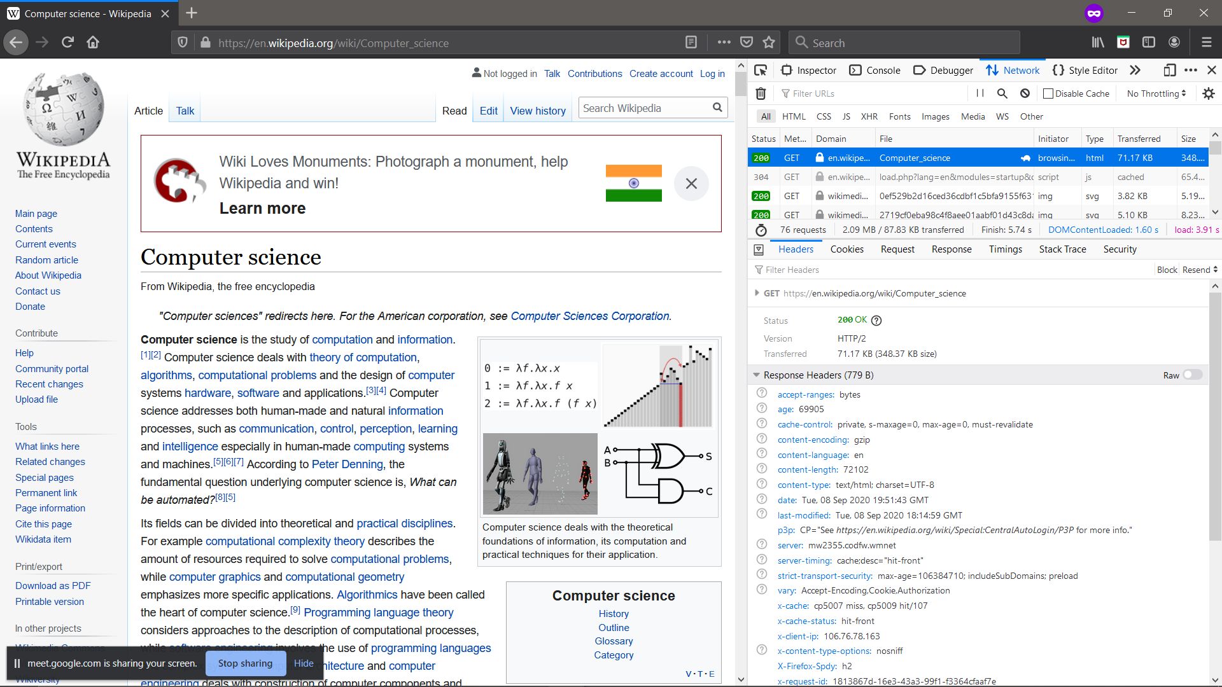
Mozilla Firefox 3

Slide 13
Mozilla Firefox 4
Gecko
SpiderMonkey

